Slide 1
1. Introduction
[ECE20016/ITP20003] Java Programming
Notes:
‹#›

Slide 2
Agenda
Computer Basics
The First Java Application
Programming Basics
Graphics Supplement

Slide 3
Computer
Composed of …
Input devices (keyboards, mouse, camera, mic,…)
Output devices (monitor, printer, speaker, …)
Storages (HDD, SSD, flash memory, CD/DVD, …)
CPU, main memory, controller, …

Slide 4
CPU and Memory
CPU - carries out only very simple instructions
Moving data from one place in memory to another
Performing some basic arithmetic (+, -, …)
Cf. program: a sequence of instructions to accomplish a task
Main memory (RAM) – stores data and instructions
Volatile
Fast
Smaller and more expensive than auxiliary memory
The only storage that CPU can access directly.

Slide 5
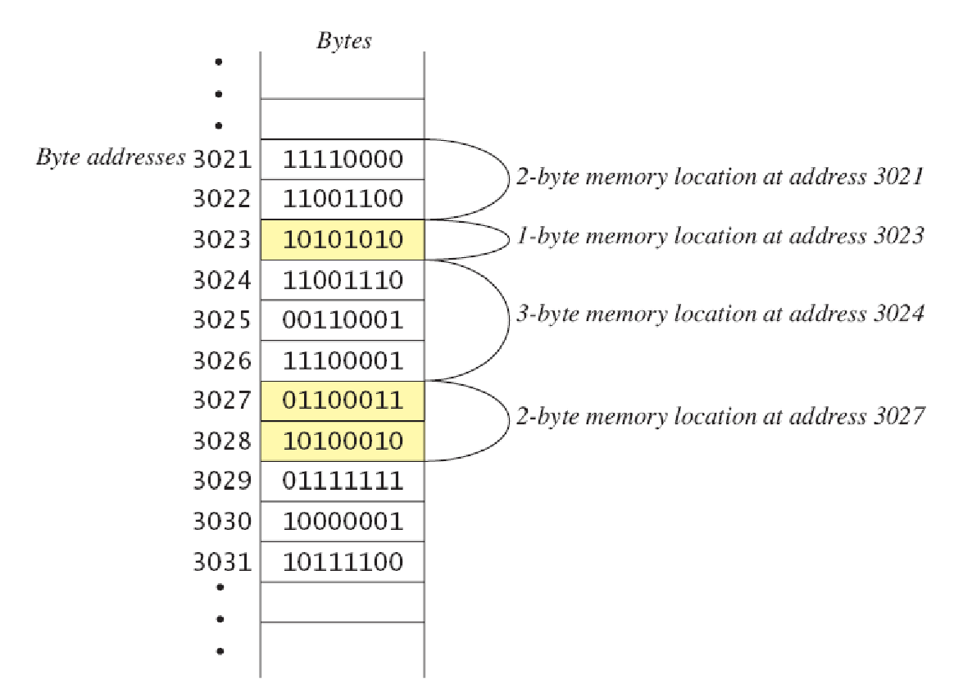
Main Memory
Main memory consists of a long list of numbered bytes.
All kinds of data are stored as a series of bits or bytes.
The location of a byte is called its address.
The address of other memory unit, i.e. WORD(2bytes) or DWORD(4bytes), is the address of the starting byte.

Slide 6
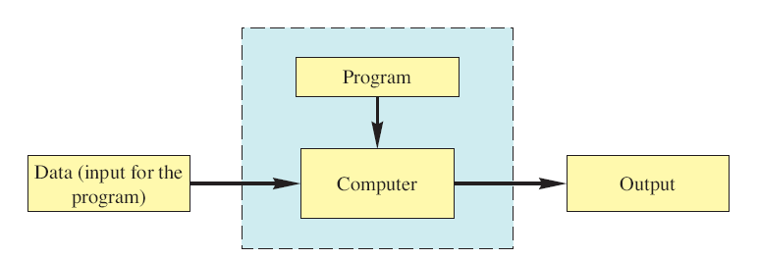
Programs
Program: a sequence of instructions for a computer to follow.
Execution of program
Program is executed by computer (+ OS)
Program takes input and produces output

Slide 7
Programming Languages
Primitive programming languages
Machine language - a sequence of machine instructions
Machine instruction: primitive instructions CPU can run.
Assembly language – a sequence of assembly instruction
Assembly instruction: symbolic representation of machine instruction
Needs translation into machine language (assembler)
High-level programming languages
Human-friendly language to describe the things the computer should do.
Only for human (cannot be executed on computer)
➔ Needs translation into machine language code. (interpreter/compiler)

Slide 8
Interpreter and Compiler
Interpreter - translates and executes each command alternatively
Translates every time the program runs.
Interactive
Compiler - translates the whole (or a part of) program into machine code (exceptions: Java, C#, …)
Compile once execute often.
Fast

Slide 9
Creating and Running C Programs
Link
Integrating objects and library modules required to execute
Notice! a program can be distributed in multiple source files.
Source 1
Object 1
Executable
Compiling
Source 2
Object 2
…
…
Linking
Source n
Object n
Library
Modules
(printf, scanf,…)

Slide 10
Java Bytecode
Java compiler translates Java program into bytecode rather than machine language.
Bytecode: machine language of a hypothetical computer known as a virtual machine, called JVM.
Intermediate form between Java program and machine code.
Easy to interpret
Java program
(.java)
Byte-code
(.class)
Machine code
for human
for machine

Slide 11
Java Virtual Machine (JVM)
JVM interprets bytecode (translation + execution)
JVM provides platform-independent environment.
There exists JVMs for various H/W’s and OS’s
Java bytecode can run on any JVM.
JVM
OS
H/W

Slide 12
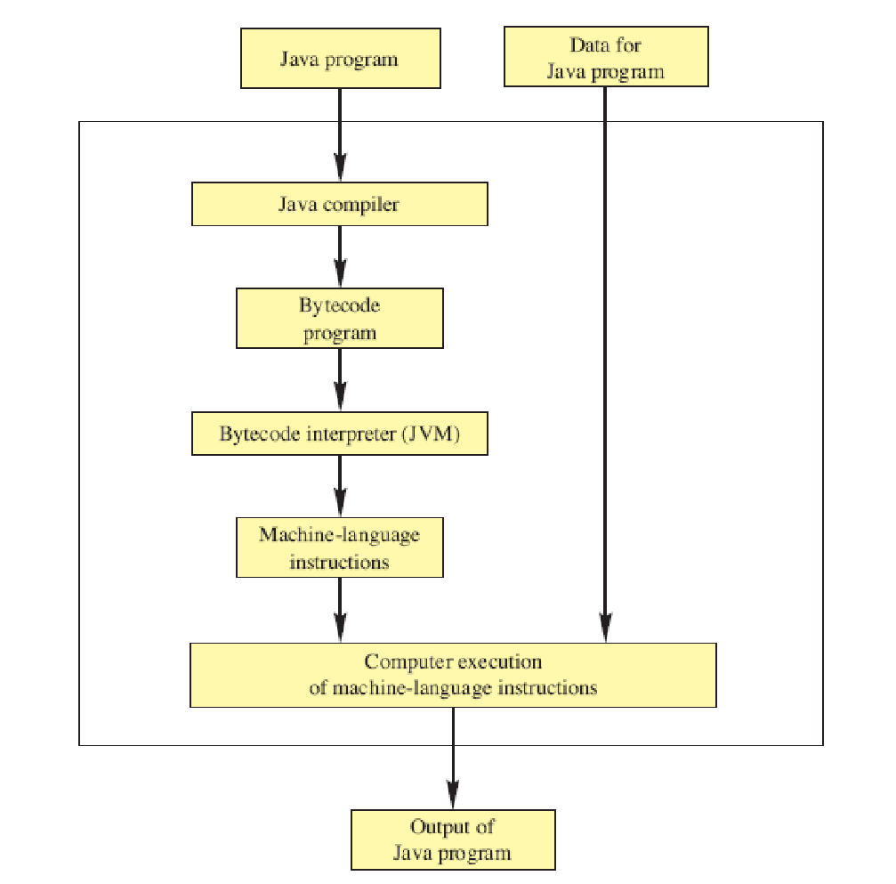
Compiling and Running Java

Slide 13
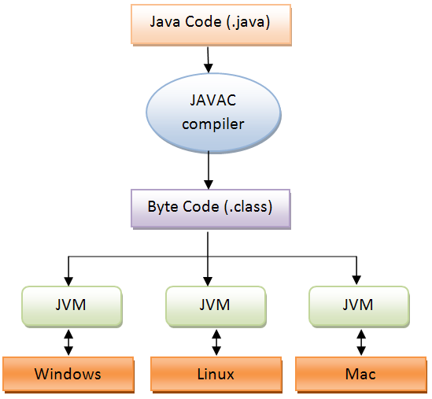
Java Virtual Machine (JVM)
JVM provides great portability.
“Compile once, run everywhere!”

Slide 14
Applications and Applets
Application: regular program.
Run on your computer
H/W + OS + VM
Applet
Sent to another location on the Internet and run there.
H/W + OS + VM + Web browser

Slide 15
Agenda
Computer Basics
The First Java Application
Programming Basics
Graphics Supplement

Slide 16
The First Java Application Program
import java.util.Scanner;
public class FirstProgram
{
public static void main (String [] args)
{
System.out.println ("Hello out there.");
System.out.println ("I will add two numbers for you.");
System.out.println ("Enter two whole numbers on a line:");
int n1, n2;
Scanner keyboard = new Scanner (System.in);
n1 = keyboard.nextInt ();
n2 = keyboard.nextInt ();
System.out.println ("The sum of those two numbers is");
System.out.println (n1 + n2);
}
}

Slide 17
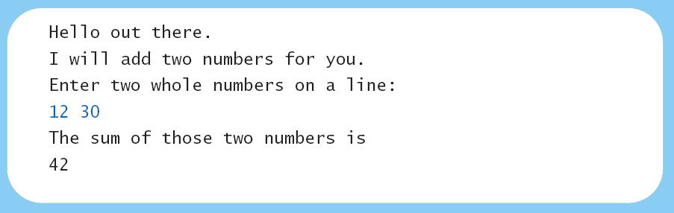
The First Java Application Program
Result

Slide 18
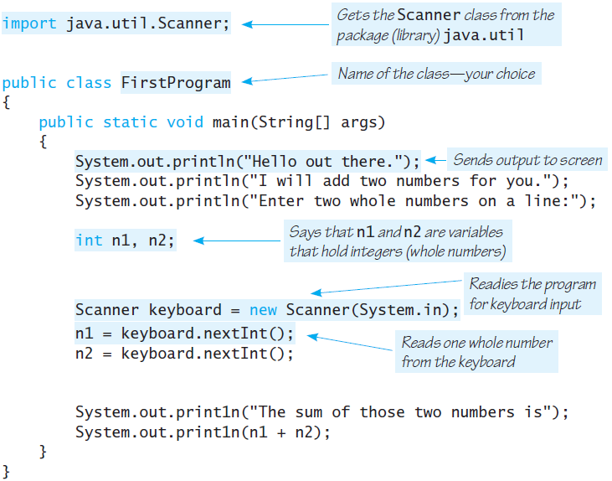
The First Java Application Program

Slide 19
The First Java Application Program
import java.util.Scanner;
Tells the compiler that this program uses the class Scanner.
class FirstProgram
public class FirstProgram
{
. . .
}
The main method
public static void main(String[] args)
{
. . .
}

Slide 20
The First Java Application Program
System.out.println()
Displays what is shown in parentheses
System.out is an object used to send output to the screen
println is the method that performs this action for the object System.out.
int n1, n2; // variable declaration
variable: a memory space with a name to store a piece of data.
int: data type (integer)
n1, n2: variable names

Slide 21
The First Java Application Program
Scanner keyboard = new Scanner(System.in);
Prepares to read from the keyboard
System.in is an object used to read input to the keyboard
n1 = keyboard.nextInt();
n2 = keyboard.nextInt();
Reads integer numbers from the keyboard

Slide 22
Writing a Java Program
A Java program is composed of smaller parts, called classes
In the code, we use three classes: FirstProgram, System, Scanner
Each class should be in a separate file with the same filename.
Ex) FirstProgram.java
Writing a Java program = writing classes
Design the whole program
Decompose it into classes
Implement each class

Slide 23
Compile and Running a Java Program
Compile and Running with JDK (Java Development Toolkit)
Compiler + JRE (incl. JVM)
cf: JRE: Java Runtime Environment (JVM + built-in classes + α)
Compile: javac FirstProgram.java
Run: java FirstProgram
➔ JDK should be installed, and its bin directory should be in PATH.
IDE (Integrated Development Environment)
Editor + compiler + runtime + debugger + …
Ex) Eclipse, NetBeans, …
Background compile
Run
Menu->Run->Run As->Java Application
Menu->Run->Run
CTRL-F11

Slide 24
Agenda
Computer Basics
The First Java Application
Programming Basics
Graphics Supplement

Slide 25
Object-Oriented Programming
Java is an object-oriented programming language, abbreviated OOP.
OOP is a technique that experienced programmers have found to be extremely helpful.
The world is made up of objects.
Ex) people, automobiles, buildings, …
Object-oriented programming (OOP) treats a program as a collection of objects that interact by means of actions.

Slide 26
Object-Oriented Programming
Objects, appropriately, are called objects.
Actions are called methods.
Objects of the same kind have the same type and belong to the same class.
Objects within a class have a common set of methods and the same kinds of data
But each object can have it’s own data values.

Slide 27
Class, Object, and Methods
Class: a type of entities
Ex) Sonata, Genesis, Galaxy Note, i-Pad…
Object: a specific entity
Ex) my Sonata (with a specific VIN and plate number)
Method: an action an object can perform
Ex) Sonata has go, stop, left_turn, right_turn, …
Attribute: component that constructs an object
Also called fields, member variable, data member, …
Ex) body, engine, wheel, tire, chair, door, trunk, …

Slide 28
OOP Design Principles
OOP adheres to three primary design principles:
Encapsulation
Polymorphism
Inheritance

Slide 29
Encapsulation
The data and methods associated with any particular class are encapsulated (“put together in a capsule”), but only part of the contents is made accessible.
Encapsulation provides a means of using the class, but it omits the details of how the class works.
Ex) accelerator pedal, brake pedal, steering wheel, …
Encapsulation often is called information hiding.
Ex) fuel injectors, automatic braking control system, power steering pump, …

Slide 30
Polymorphism
From the Greek meaning “many forms”
The same program instruction adapts to mean different things in different contexts.
A method name produces results that depend on the class of the object that used the method.
Ex) ‘go’ method of an automobile vs. ‘go’ method of an airplane.

Slide 31
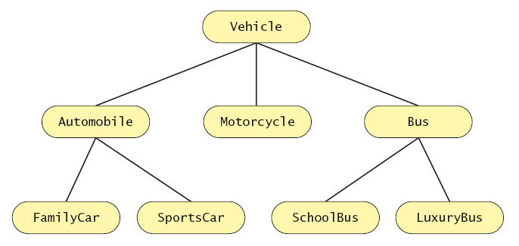
Inheritance
Classes can be organized using inheritance.
‘is a’ relation
A class at lower levels inherits all the characteristics of classes above it in the hierarchy.
Inherited characteristics do not need to be repeated.
New characteristics are added.

Slide 32
Inheritance in Java
Used to organize classes
New characteristics are added.

Slide 33
Algorithms
An algorithm describes a means of performing an action.
Algorithm = a series of actions
cf. program = a series of instructions (or commands)
An abstracted form of program.
For human, not machine
Once an algorithm is defined, expressing it in Java (or in another programming language) usually is easy.
An algorithm must be expressed completely and precisely.
Algorithms usually are expressed in pseudocode.

Slide 34
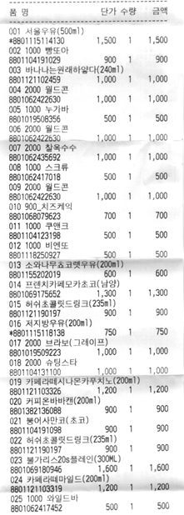
Example: Total Cost of All Items
Write the number 0 on the whiteboard.
For each item on the list
Add the cost of the item to the number on the whiteboard
Replace the number on the whiteboard with the result of this addition.
Announce that the answer is the number written on the whiteboard.

Slide 35
Reusable Components
Most programs are created by combining existing components.
Programs NOT usually created entirely from scratch.
Reusing components saves time and money.
Reused components are likely to be better developed, and more reliable.
New components should be designed to be reusable by other applications.
Java provides many classes
http://docs.oracle.com/javase/7/docs/api/

Slide 36
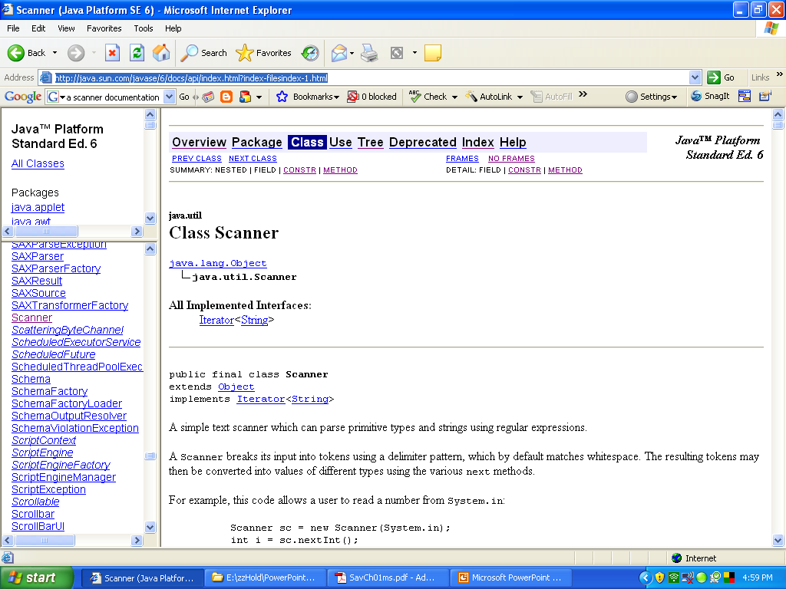
Java Platform API
It moved to http://docs.oracle.com/javase/7/docs/api/
Description of class Scanner
Package names
Class names

